Slide 1


PROJECT PRESENTATION
Class & Team No: | IV CSE A & TEAM NO 7
Review No: | VII Semester Project (Odd Sem. Phase-I)
Title: | ALAS(ADVANCE LUMINOUS ASSISTANT SYSTEM)
Date: | 29/01/2024
Time:
KPR Institute of Engineering and Technology, Coimbatore, Tamil Nadu, India
1
Notes:
1

Slide 2
Advance Luminous Assistant System
Aravind RM – 20cs013
ArunPrakash SK – 20cs018
Dheepadarshan LB – 20cs045
Guided by:
Mr.Thivaharan S
Assistant Professor (Sr.G.) -CSE
KPR Institute of Engineering and Technology, Coimbatore, Tamil Nadu, India
2
Notes:
2

Slide 3
INDUSTRY ASSOCIATED
Industry Name - BSH Hausgeräte Engineering Company
Address details - BSH GGS Office Mind comp tech park, Whitefield, Bengaluru, Karnataka 560048
Industry supervisor :
Shwetha Shivalingapa
(Head Service Management)
KPR Institute of Engineering and Technology, Coimbatore, Tamil Nadu, India
3
Notes:
3

Slide 4
ABSTRACT
ALAS focused on the autonomous functionality of the automobiles and especially on the
luminous element of the vehicles. Alas fully focused on its architecture, which relies on communication between neighboring vehicles.
To enhance functionality and accuracy, machine learning components will be added to the existing system with the help of the powerful Raspberry Pi. On the other hand, user interface plays a major role in the ALAS environment, So the updated version of the module provides the user with a dedicated application that allows the user to take total control of the luminous part as well as the manual sensor alignment that can be adjusted through the application, which also gives the pump accuracy.
KPR Institute of Engineering and Technology, Coimbatore, Tamil Nadu, India
4
Notes:
4

Slide 5
INTRODUCTION
As we know in our day to day life driving a car is became a part of it to migrate from or to go from one place to other in this part we need to check out importance of safety , the number of accidents occurring night is much higher when compare to the day .
And it is because of the high beams the driver’s using in an inappropriate scenario or situation and it cause a huge accident for them and also for others.
So we design a system called ALAS[Automatic Luminous Assistant System] and it basically controls high and low beam automatically.
KPR Institute of Engineering and Technology, Coimbatore, Tamil Nadu, India
5
Notes:
5

Slide 6
OBJECTIVE
The summary of this project is “The Automatic High beam assist” can switch high beam of a vehicle to low beam whenever it gets signal from another vehicle giving high beam of light.
If the opposite vehicle also have this device the opposite vehicle will turn it’s high beam to low beam automatically.
The device will also work even it can detect the presence of any nearby object at the same time. And by using this device, rate of high way road accident can be reduced.
KPR Institute of Engineering and Technology, Coimbatore, Tamil Nadu, India
6
Notes:
6

Slide 7
LITERATURE SURVEY
AUTHOR | TITLE AND YEAR | METHODOLOGY | ADVANTAGES | DISADVANTAGES
Yakusheva Nadezda1 , Gian Luca Foresti2 and Christian Micheloni2 | An ADAS Design based on IoT V2X Communications to Improve Safety | Using Vehicle-to-everything technology refers to the sensors, cameras and wireless connectivity that allow vehicles to share real-time information with their drivers, other vehicles, pedestrians and roadway infrastructure like traffic lights. | Seamless communication with neighboring cars and IoT equipment's. | General overview on communication technology and not focused on individual component.
Jaswanth Nidamanuri , Chinmayi Nibhanupudi, Rolf Assfalg, and Hrishikesh Venkataraman | A Progressive Review: Emerging Technologies for ADAS Driven Solutions | This paper identifies the research gaps, reviews the state-of-the-art looking at the different functionalities of ADAS and its levels of autonomy. | Implementation of ADAS for less disciplined roads. | More focused on machine learning components rather than on road implementation.
*
KPR Institute of Engineering and Technology, Coimbatore, Tamil Nadu, India
7
Notes:
7

Slide 8
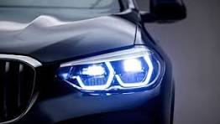

EXISTING SYSTEM
It is the system where it is only available for BMW cars and its specially applicable in United kingdom(UK) manufactured BMW not in India and it is assigned in the cars of higher range not for low or middle budget cars
In BMW With the High Beam Assistant, when a front facing camera integrated into your BMW near the rearview mirror detects the headlights of oncoming vehicles from a distance of 700 meters, the system turns your low beams on automatically.
KPR Institute of Engineering and Technology, Coimbatore, Tamil Nadu, India
8
Notes:
8

Slide 9


PROPOSED SYSTEM
Working on the hardware system which is to be implemented in the vehicles to access the headlights of it respectively.
And also we are going to do a dashboard of ALAS to monitor the whole system and the information of the headlamps of the particular car.
KPR Institute of Engineering and Technology, Coimbatore, Tamil Nadu, India
9
Notes:
9

Slide 10
EXPERIMENTAL SETUP
KPR Institute of Engineering and Technology, Coimbatore, Tamil Nadu, India
10
Notes:
10

Slide 11
IMPLEMENTATION DETAIL
KPR Institute of Engineering and Technology, Coimbatore, Tamil Nadu, India
11
Notes:
11

Slide 12
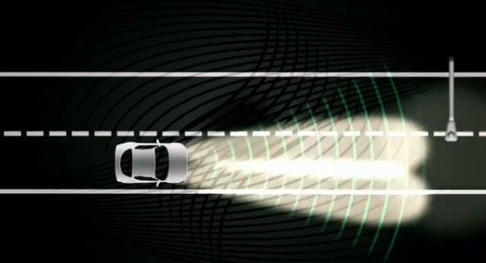
Expected Results
---Vehicle running with high beam
Vehicle running with high detects another light --- -
object
KPR Institute of Engineering and Technology, Coimbatore, Tamil Nadu, India
12
Notes:
12

Slide 13
Expected Results
--- The Vehicle detects the other car and changes from
high to low
Beam automatically
KPR Institute of Engineering and Technology, Coimbatore, Tamil Nadu, India
13
Notes:
13

Slide 14
CONCLUSION
ALAS helps a lot to reduce the road accidents.
ALAS can bring a great change in the transport system as it helps a lot to drive the vehicles in a safe manner and also helps in the night time.
Almost all vehicle accidents are caused by human error, which can be avoided with Advance Luminous Assistant System(ALAS).
The role of ALAS is to prevent deaths and injuries by reducing the number of car accidents and the serious impact of those that cannot be avoided.
s
KPR Institute of Engineering and Technology, Coimbatore, Tamil Nadu, India
14
Notes:
14

Slide 15
REFERENCES
[1] Headlamp - Wikipedia, the free encyclopedia
http://en.wikipedia.org/wiki/Headlamp
[2] HIGH Beam ASSIST
http://www.audizine.com/forum/showthread.php/487621-HIGHBeam- ASSIST
[3] AUTOMATIC HEADLIGHT INTENSITY
CONTROLLER http://zonascience.blogspot.com/2009/08/automatic-headlightintensity.html
[4] High Beam Control: making driving safer and more convenient
http://www.mazda.ie/videos/technology/high-beam-control-makingdrivingsafer-and-more-convenient/
KPR Institute of Engineering and Technology, Coimbatore, Tamil Nadu, India
15
Notes:
15

Slide 16
Thank you.
*
KPR Institute of Engineering and Technology, Coimbatore, Tamil Nadu, India
16
Notes:
16

